Slide 1
Introduction to the FiRa® Consortium
June 2026

Slide 2

Our vision is to transform
the way we interact with our environment by enabling precise location awareness for people and devices.
2

Slide 3











Our Members are Industry Leaders
FiRa is supported by a team of industry leaders committed to advancing UWB
Current Sponsor Members
*Status as of May June - See list of members at www.firaconsortium.org/about/members

Slide 4
FiRa Consortium Goals
Foster a framework to facilitate broad adoption of UWB and its fine-ranging and positioning capabilities
Spur
Innovation
Ease
Adoption
Support Interoperability
  Support the development
  of compelling use cases across broad business domains
  Provide a unique opportunity to explore and define transformative uses for UWB technology
  Enable member companies to work together to deliver the building blocks, tools, and technologies needed
  to integrate UWB quickly and seamlessly
  Foster a robust and reliable UWB ecosystem to enable rapid technology deployment
Define and drive specifications intended
to support interoperability between UWB-enabled products
Develop a certification program to ensure interoperability and consistent performance

Slide 5
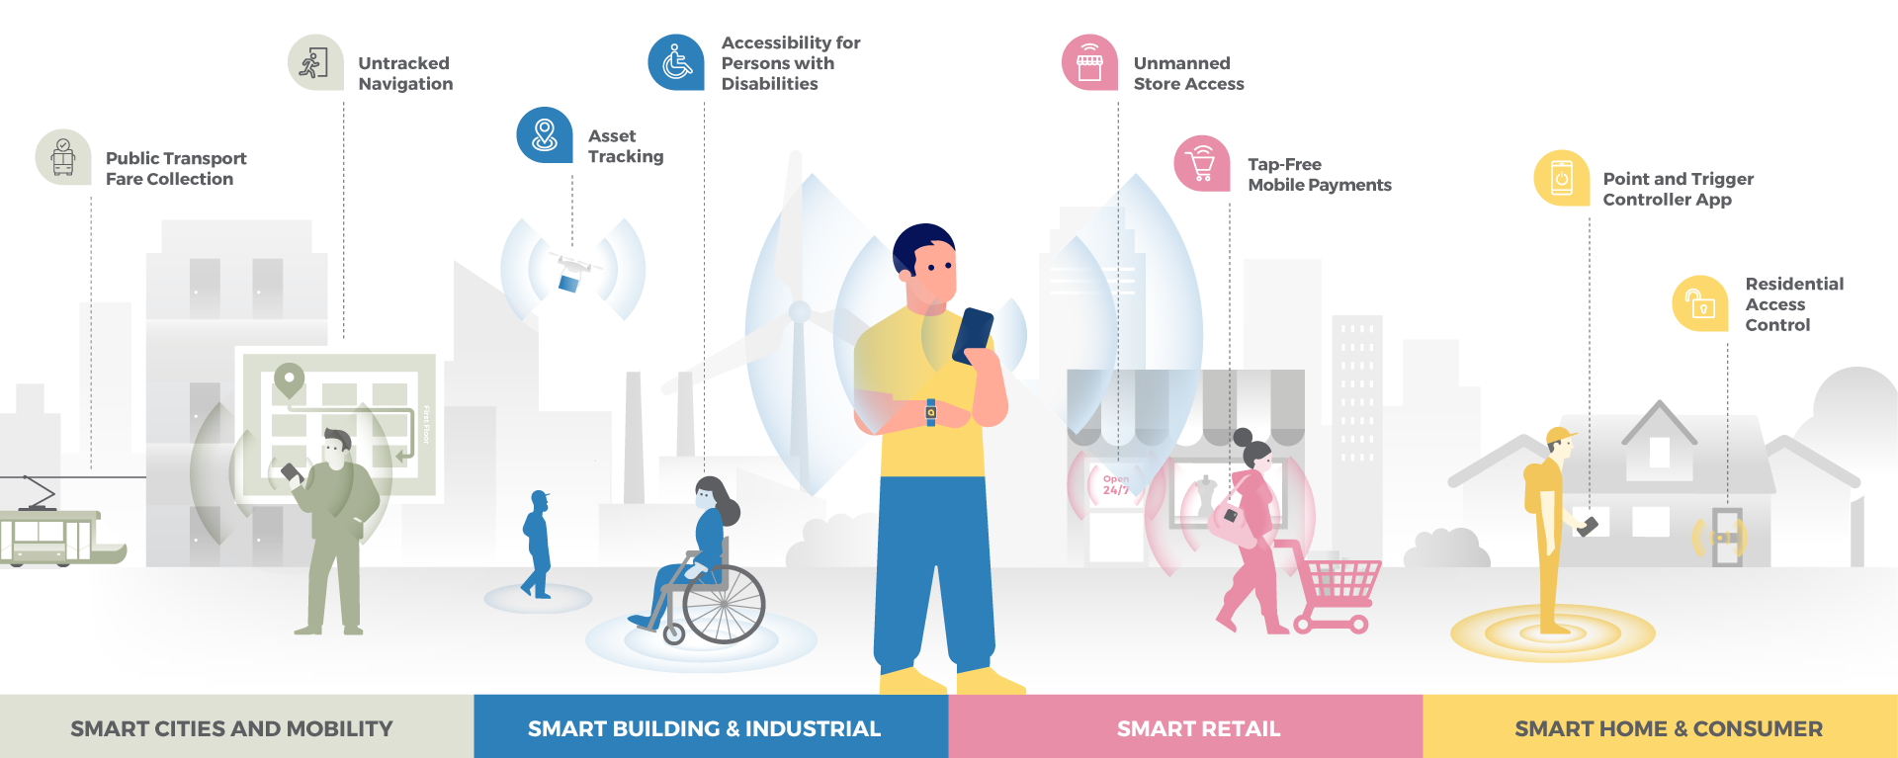
UWB Positively Impacts User Experiences
Transforming the connectivity experience
firaconsortium.org/discover/use-cases

Slide 6





FiRa’s Commitment to Collaboration
To create a stronger ecosystem for UWB technology as a whole
FiRa is committed to collaborating with other consortia and industry stakeholders to develop a stronger UWB ecosystem. They include:
Involved with the Harmonized Standards and other regulatory bodies in Europe
Formed the Joint UWB
MAC PHY Working Group (JUMPWG) to advance UWB technology specs
used in the CCC Digital Key.
Work together to enable the implementation and deployment of UWB-enabled secure wireless payment systems
COLLABORATION
Support coexistence and seamless integration of RTLS use cases through
a joint working group.
Partner to interact with regulatory authorities to ensure global deployment of UWB technology.
Collaborate to promote and grow an interoperable UWB ecosystem and certification program.

Slide 7

FiRa Works to Grow the UWB Market
To build widespread adoption of UWB technology
\
FiRa drives market adoption of UWB by:
  Creating compelling use cases across multiple markets and applications
  Evangelizing the capability of UWB technology
      Through videos, webinars, blog articles, social media, and other digital assets
  Advocating for UWB with government and regulatory bodies to drive fair spectrum rulings for UWB deployments
  Fostering an interoperable UWB ecosystem across chipset, device, and service infrastructure through standards and certifications
ADOPTION

Slide 8

FiRa Certification Program
Aimed at driving UWB interoperability among UWB devices
\
FiRa’s Certification Program
        Offers defined processes for verifying that candidate devices
        conform to FiRa requirements and Test Specifications
        For Core Certification, the device must meet the
        FiRa-specified MAC/PHY Conformance and Interoperability Test Specifications
        The FiRa Certified logo can be used by FiRa members who have devices that fulfill the criteria of the Certification Program
Learn more about the FiRa Certification Program at
https://www.firaconsortium.org/certifications

Slide 9
FiRa’s Core Certification Architecture
Builds on the foundation of the IEEE 802.15.4/4z standard
\
FiRa-Enabled Application
FiRa’s Core Certification Program focuses on the UWB Subsystem (UWBS) functionality which consists of three different layers:
  FiRa UWB Physical (PHY)
  FiRa UWB Media Access Control (MAC)
  FiRa UWB Link Layer
FiRa Framework
UWB Subsystem (UWBS)
FiRa UWB Link Layer
FiRa UWB MAC
FiRa UWB PHY

Slide 10

FiRa’s Core Certification Program Use Cases
Everyday possibilities using UWB
\
Currently, the FiRa Core Certification Program v4.0 is available for the following use cases:
        Public Transport Fare Collection
        Untracked Navigation
        Asset Tracking
        Tap-free Payments
The FiRa Framework and application interoperability testing program is currently being defined.
FiRa’s Test and Technical Specifications are available: https://www.firaconsortium.org/resource-hub/specifications

Slide 11
Focus on UWB Security
The FiRa Security Working Group
\
FiRa’s Security Working Group (SWG) addresses
security-related topics within FiRa with a current focus on:
        Analyzing use cases with regards to security needs
        Identifying assets to be protected
        Defining security mechanisms to protect the assets
        Defining security requirements products must meet
        Defining a security certification scheme for products
SECURITY

Slide 12
UWB Security in the Market
FiRa’s Security Working Group (SWG)
How does the UWB security impact the market?
Trustworthy components due to security evaluations and certification by independent bodies
UWB applications are robust against relay attacks
Unprecedented convenience in use cases with security needs such as:
  Tap-free corporate access
  Hands-free public transport fare collection
  Passive vehicle entry and start capabilities
  Tap-free mobile payment
SECURITY BENEFITS

Slide 13
FiRa Working Groups
Defining the UWB ecosystem
Working Group Steering Committee
Requirements WG
Compliance & Certification WG
Working Groups (WGs)
and Task Groups (TGs)
are member driven and collaborate to address
the various needs of
the Consortium.
Regulatory WG
Marketing WG
Technical WG
Security WG
  Core Sub Group
  Framework & Profiles Sub Group

Slide 14

The Benefits of Joining FiRa
Maximize the benefits of UWB for your brand
\
The FiRa Consortium provides a way for a wide range of product and solution companies to create a broad UWB ecosystem for combined future success.
As a FiRa Consortium member, your company will be able to:
        Collaborate with UWB market leaders in semiconductors, devices, and systems
        Build a network of connections in the UWB ecosystem
        Explore and ensure interoperability of your UWB products
        Get your products certified
JOIN FiRa
Apply Today

Slide 15
Contact Us
Directors
SK Yong, Board Chair
boardchair@firaconsortium.org
Rias Al-kadi , Board Vice-Chair
boardvicechair@firaconsortium.org
Ramesh Songukrishnasamy, Director and Treasurer
treasurer@firaconsortium.org
FiRa Admin
admin@firaconsortium.org
+1 503 619-5232
CONTACT US
www.firaconsortium.org

Slide 16
Appendix
1
Membership
Learn about membership in the FiRa Consortium
FiRa IPR Policy
2
High level overview of FiRa Consortium IPR Policy
FiRa Bylaws
3
High level overview of FiRa Consortium Bylaws
LEARN MORE
Stakeholders
4
High level overview of the industries our stakeholders participate in

Slide 17
Membership
 | Sponsor¹ | Contributor | Associate | Adopter | Test Lab | Academic & Educational | Affiliate²
Board of Directors | ✓
Working Group Steering Committee Participation | ✓ | ✓
Working Group Leadership | ✓ | ✓
Working Group Voting Rights | ✓ | ✓
Working Group Participation | ✓ | ✓ | ✓ |  | Compliance & Certification WG only | ✓ | ✓
Access to Final Specifications | ✓ | ✓ | ✓ | ✓ | ✓ | ✓ | ✓
Certify Products | ✓ | ✓ | ✓ | ✓ |  |  | ✓
FiRa Plugfest Participation | ✓ | ✓ | ✓ | ✓ | ✓ | ✓ | ✓
Apply for Authorized Test Lab |  |  |  |  | ✓
Annual Membership Fee (USD) | $800K | $50K | $30K (if revenue ≥ $50M) or $7.5K (if revenue < $50M | $15K (if revenue ≥ $50M) or $5K (if revenue < $50M) | $5K | $2.5K (one time only) | No charge
¹As part of the Sponsor Member application review and approval process, a presentation to the FiRa Consortium Board of Directors (“Board”) may be requested, and the Board may, on a reasonable and non-discriminatory basis, take into account the impact that the admission of an applicant may have on the balance of representation on the Board (e.g., with reference to industry segments and geography).
²Affiliate Membership is limited to companies related by majority ownership to a current Sponsor or Contributor Member of FiRa Consortium.

Slide 18
Overview of FiRa IPR Policy
Applicable to all Members and Member Representatives, and others bound by separate written agreement
Governs the ownership, licensing, and treatment of intellectual property that is contributed to, generated by, or necessary for
the implementation of standards developed as part of the FiRa Consortium activities
Subject to the specific terms of the IPR Policy, in general:
  Members (and their Related Parties) participating in FiRa Consortium Working Groups commit to license Necessary Claims on RAND (Reasonable and Non-Discriminatory) or RAND-Z (RAND with Zero royalty) terms, and may
  withhold Necessary Claims, by submitting a timely written declaration form
  Members that did not participate in the applicable development group may (but are not obligated to)
  make RAND or RAND-Z commitments, or withhold licenses to Necessary Claims by submitting a written declaration form
  New incoming members are not obligated to make license commitments with respect to Standards approved prior to the start of membership
Patent calls before technical meetings
No obligation to conduct patent searches for Necessary Claims

Slide 19
Overview of FiRa Bylaws
The Bylaws establish the rules governing the operations of the organization, including the rights of members, rules for meetings and corporate actions, voting and quorum requirements, confidentiality, and other matters
Delaware non-profit corporation with 8 classes of membership
    Sponsor, Contributor, Associate, Adopter, Test Lab, Academic & Educational, Affiliate, and JUMPWG
Directors Sponsor members each designate 1 director and up to 2 alternates
Officers 2-year term, elected by Board of Directors, compensation possible
Board of Directors establishes Working Groups, Task Groups, member committees, sub-committees, special interest groups, etc.
Indemnification and insurance possible for directors, officers, employees and agents
FiRa BYLAWS

Slide 20
Key Stakeholders Represented in the FiRA Consortium
Semi-Conductor Manufacturers
Technology Providers
Test Tool Developers
Test Labs
Device Manufacturers
System Integrators
Service Providers
STAKEHOLDERS
Academic and Educational Providers

